Slide 1
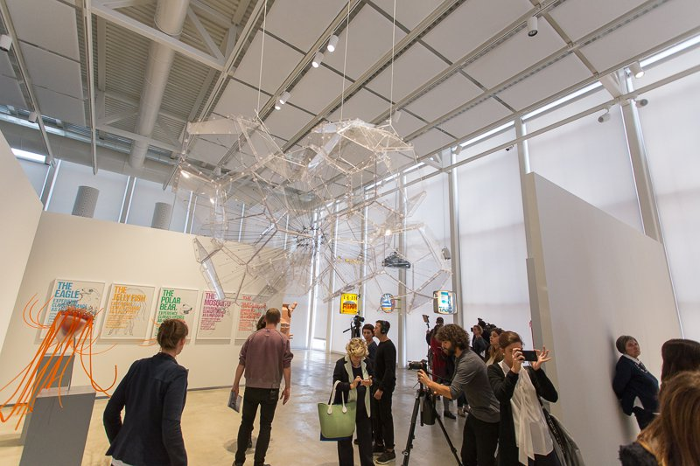


Building Memories with Augmented Reality Applications
Fondazione Golinelli, Bologna
by: Oz, Beatrice, Alessandro

Slide 2
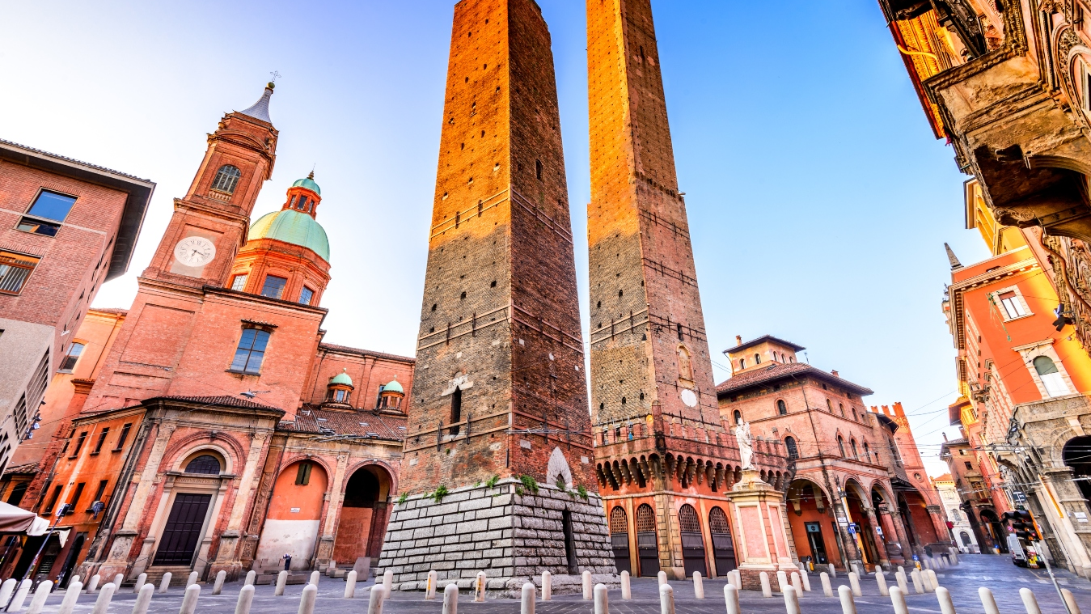
So, what do you think about our little city?

Slide 3
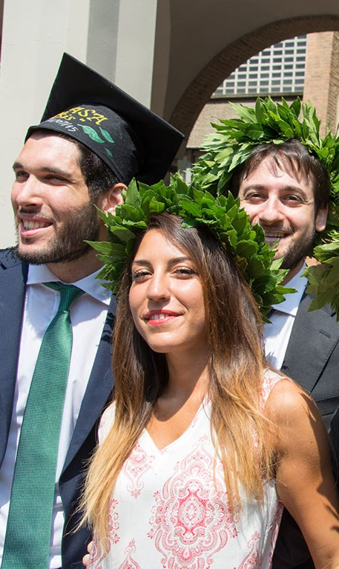
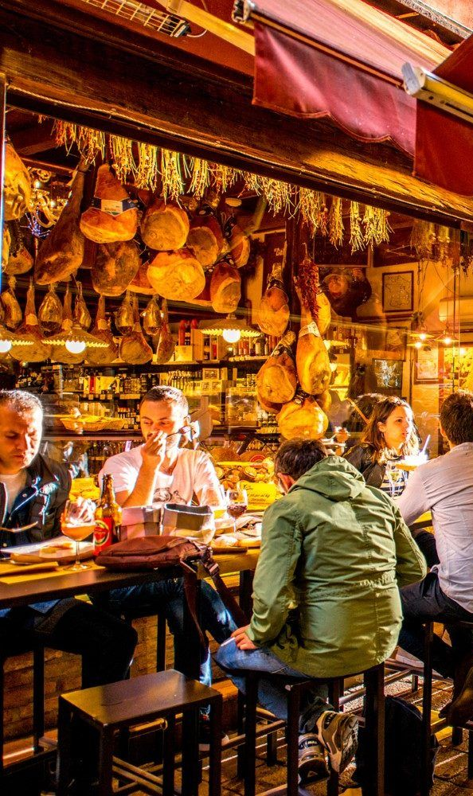
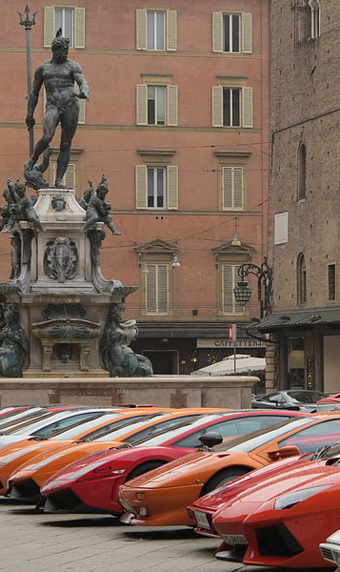
La Dotta La Grassa La Rossa

Slide 4
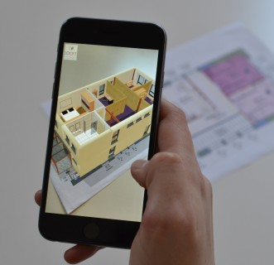
WHAT WE ARE GOING TO DO?
Learn Unity game development
Design an augmented reality experience
Run the app on our mobile phones!
CREATE MEMORIES IN DIGITAL ☺

Slide 5

Two Lies, One Truth

Slide 6
Can anybody explain what is augmented reality?

Slide 7
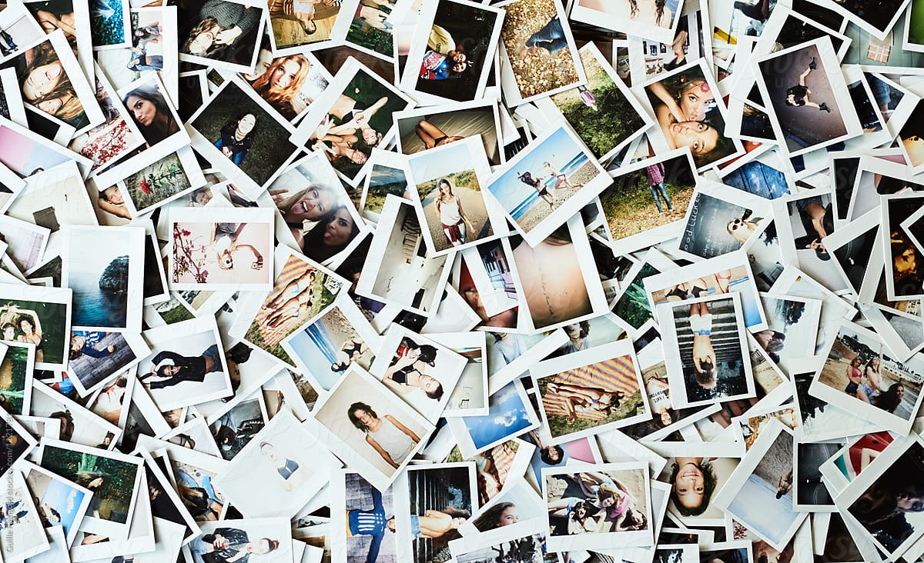
MEMORIES FROM BOLOGNA
Which image? Why?
What is the experience that is related to it?

Slide 8
VOTES FOR BEST PHOTOS sit near the photo you liked the most

Slide 9
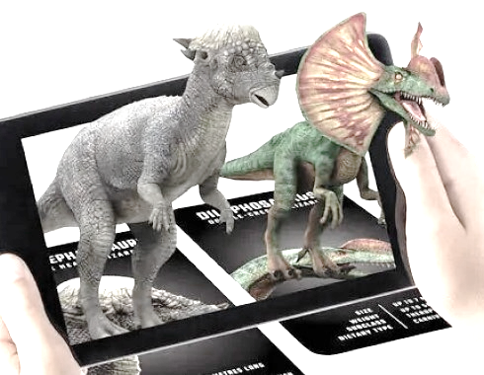
PLAN
1st October
6th October
7th October
Unity development of AR app
Building the 3D model
Adding content and presenting

Slide 10
DAY 1
10:30-14:30: dev of the AR app
14:30-15:00: sit in groups. Brainstorm interaction
15:30-16:30: present ideas.

Slide 11
Building an AR app with Unity (its simpler than you think)
Open Unity. 3D project
​Remove camera.
Convert project to mobile.
Install AR Foundation from package manager: AR Foundation. ARcore. ARkit.
Add AR session and AR Session Origin.
Add AR Tracked Image Manager
Add Reference library
Image target saved with lowercase chars
keep texture at runtime
Size: 0.1 on width
Add Prefab Image Pair Manager
Scale of the prefab should be 0.1 (10% of a meter is corresponding to the size of the marker)

Slide 12
DESIGN INTERACTION
Image
What object to place above it
How can we recreate that memory?

Slide 13
DAY 2
9.30-11.00: 3D modeling workshop
11.00-13.00: working in the group

Slide 14
DAY 3
9.30-13.00 working
14.30-15.30 presentations
15.30-16.30 future inspiration

Slide 15
AR Workshop
Thank you for your hard work
Fondazione Golinelli, Bologna
by: Oz, Beatrice, Alessandro

Slide 16
Rules
Say hi to new person
Appreciate other people opinion. Change and difference is a wonderful thing in this world. we will disagree on stuff, but we will listen to their opinion
Be brave to share your opinion
Respect the place we are at
No violence
Be ready to learn all the time. Any person can teach you.
Look for help. ask for help and be brave to offer one.
If during the event something makes feel uncomfortable, rejected, unwelcomed, threatened – please come to speak with us.

Slide 17
Create my own dictionary and control. https://youtu.be/I9j3MD7gS5Y

Slide 18
Swiss project
Beatrice and oz
7-9-2021

Slide 19
25 participants
3 – 5 in group

Slide 20
Worksop dates
1 October
6 and 7 october

Slide 21
Before workshop
Swiss students will make a tour in bologna
Make a lot of photos of the places they like

Slide 22
Application
Image (golinelli logo or one of the images) > 3d model (something we already have)
Build the app the phone
Content :
3d model: built with external tool (sketchup, tinkercad, rhino fusion)
Best: fbx
Also ok: obj, dae, …
Textures (colors, ocllusion, normal map, height map…)
Music
(mp3) download from internet.
Free sound sources (freesound.org)
Recordings (speech, street sound)
Animations (created with unity)
2d images animation
Video

Slide 23
Time plan
venerdì 1 ottobre: (we have working AR application for every team)
9.30-10.00 tour Opificio Golinelli
10.15-10.45 voting on photos
10.45-12.15 sviluppo di un progetto di addestramento (uguale per tutti)
14.30-15.00 sviluppo di un progetto di addestramento (uguale per tutti) / add tips to unity or brainstorm
15.00-15.30 brainstorming (Decide about the interaction, 3d models, music etc)
15.30-16.30 idea presentation and validation
mercoledì 6 ottobre:
9.30-11.00 3d workshop
11.00-13.00 mentoring per sviluppo di un progetto autentico per ogni team
giovedì 7 ottobre:
9.30-13.00 mentoring per sviluppo di un progetto autentico per ogni team
(only Oz) 14.30/15.30 presentations
(only Oz) 15.30-16.30 advanced sviluppo / inspiration for future. cetificate

Slide 24
28 martedi: first concept
1 October venerdi: unity core AR app
Making the content (video and sounds)
5 October: tshirt printed + AR target
6 October mercoledi:
switch AR target
3d model + content
7 October giovedi: content + presentation

Slide 25
Details plan: first day
Hello ☺
Part 1: Impression from bologna. They speak
Part 2: Print photos, spread on the floor. Vote for the best photos.
Part 3: unity application building (individual work, #num of computers to check)

Slide 26
Day 2
Part 1: Best 5 photos put on the table. People sit near the photo they like the most.
Move people to make sure we have enough in all groups…
Part 2: brainstorm inside the group about the interaction
Part 3: present the idea to ALL the groups and us, receive feedback.
Part 4: 3d modeling workshop

